Slide 1
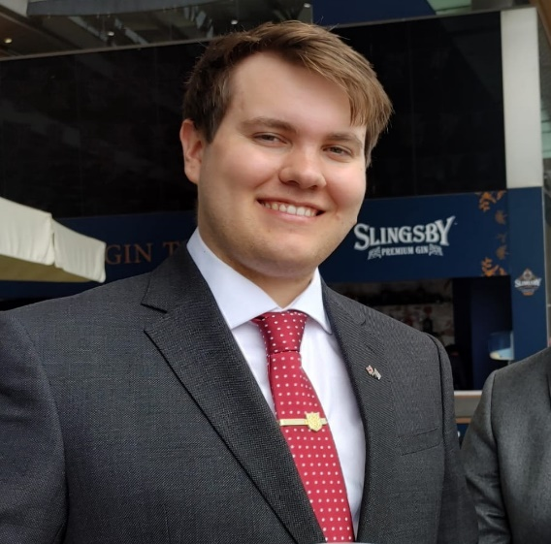
Starting Now
CyberStrikeAI: The first AI-augmented hacking framework to go global
Will Thomas
Senior Threat Intelligence Advisor

Slide 2

CyberStrikeAI
The first AI-augmented hacking framework to go global

Slide 3
About WILL THOMAS
Working for Team Cymru, the first ever Threat Intelligence provider specialising in NetFlow communications and adversary infrastructure tracking
Previously the Head of Threat Hunting at Equinix, the world’s largest data center company
Co-author of SANS FOR589: Cybercrime Investigations
Author of the BushidoToken Threat Intel blog
Co-founder of BSides Bournemouth
Will Thomas
Senior Threat Intelligence Advisor

Slide 4
Agenda
01
The Evolving Threat Landscape
02
Team Cymru’s Role
03
Introduction to CyberStrikeAI
04
The Developer’s State Affiliations
05
Global Tracking & Infrastructure
06
CyberStrikeAI NetFlow Analysis
07
The Broader AI Toolset
08
Outlook & Recommendations

Slide 5
Section 1: The Evolving Threat Landscape

Slide 6
Section 1: The Evolving Threat Landscape
How the Threat Landscape is Evolving with AI:
Fraud & Scams: AI videos of celebrities or attractive people
Verification Bypasses: KYC controls relying on videos/images
Fake Interviews: AI videos, fake resumes & websites
AI Jailbreaking: Using frontier models for fraud & cybercrime
Automating Cyberattacks: Script generation, tool & infra creation
Improving Extortion: Mass data analysis for most sensitive info
>

Slide 7
Section 2: Team Cymru’s Role

Slide 8
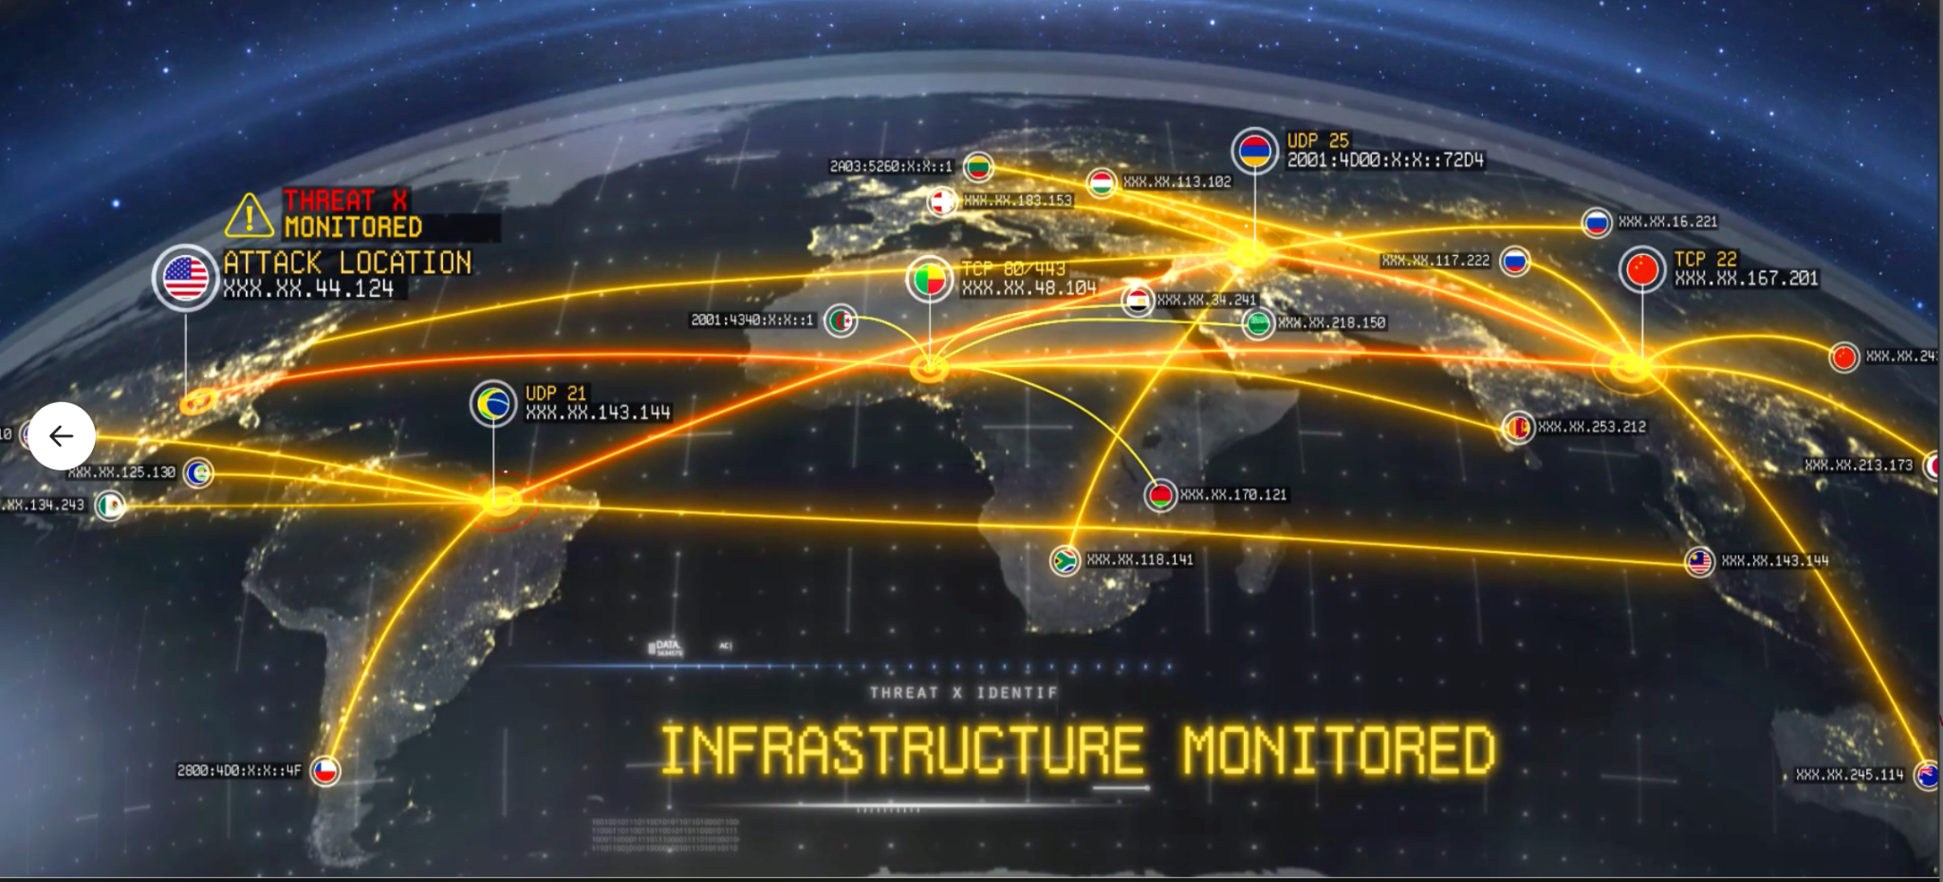


Section 2: Team Cymru’s Role
The World’s Largest IP Intelligence
Data Ocean
Team Cymru has unmatched visibility of Internet telemetry across the globe, made possible from 25+ years of building trust across 800 data sharing partnerships and our Community.
>

Slide 9
Section 3: Introduction to CyberStrikeAI

Slide 10
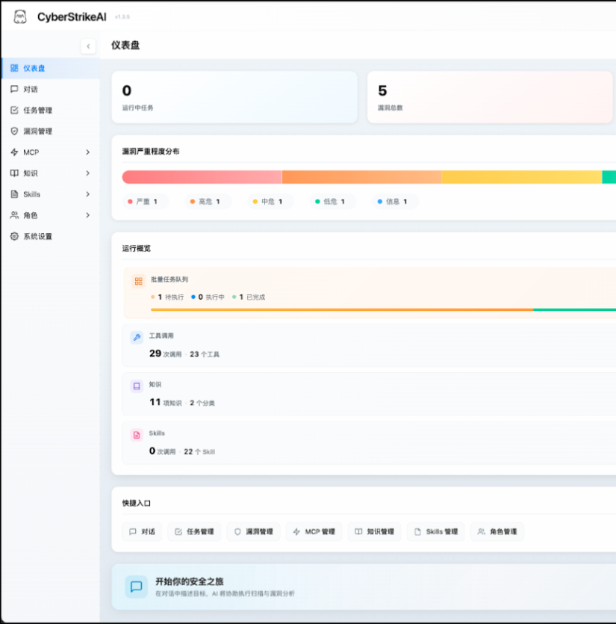
Section 3: Introduction to CyberStrikeAI
What is CyberStrikeAI?
An AI-native security testing platform built in Go.
It integrates 100+ security tools
It has an intelligent orchestration engine
It can do role-based testing with predefined security roles
It has a skills system with specialized testing skills
It also comprehensive lifecycle management capabilities
>

Slide 11
Section 4: The Developer’s State Affiliation

Slide 12
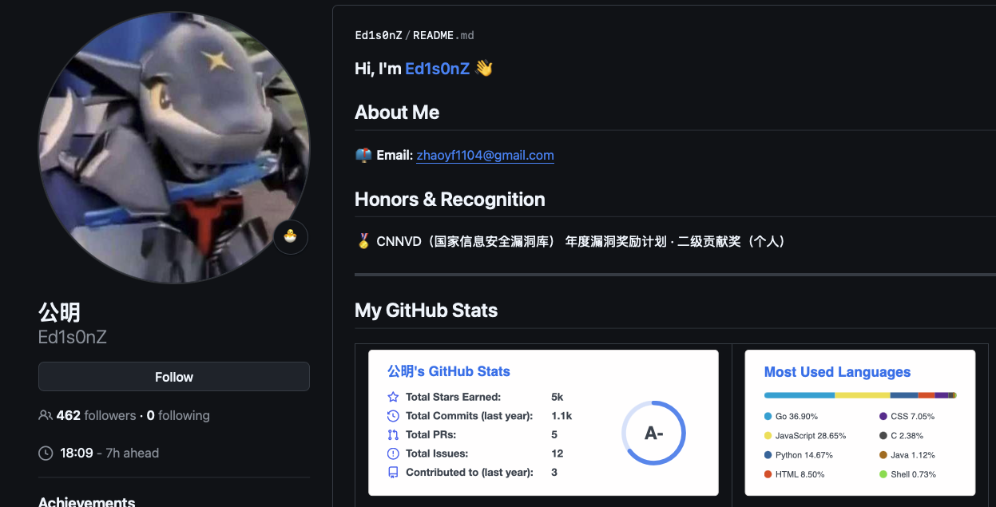
Section 4: The Developer’s State Affiliation
CyberStrikeAI’s developer: “Ed1s0nZ”
>

Slide 13
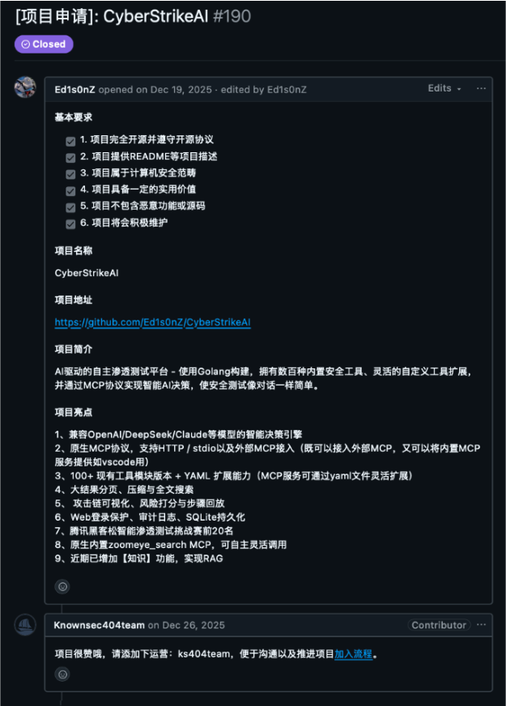
Section 4: The Developer’s State Affiliation
Ed1s0nZ’s GitHub activities indicate they interact with organisations that support potentially Chinese government state-sponsored cyber operations.
This includes Chinese private sector firms that have known ties to the Chinese Ministry of State Security (MSS).
A number of GitHub activities potentially link Ed1s0nZ to the Chinese state-sponsored cyber operations.
On 19 December 2025, Ed1s0nZ posted CyberStrikeAI to Knownsec 404’s Starlink Project.
Based on published reporting by DomainTools and others, Knownsec does work for the MSS and the Chinese People’s Liberation Army (PLA).
>

Slide 14
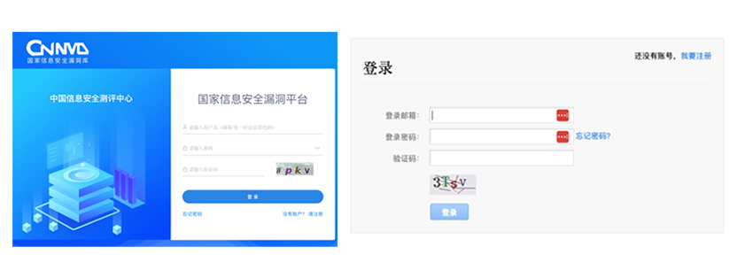

Section 4: The Developer’s State Affiliation
On 5 January 2026, Ed1s0nZ added to their GitHub profile “CNNVD（国家信息安全漏洞） 2024 年度漏洞奖励计划 · 二级贡献奖（个人). Translation: CNNVD (Chinese National Vulnerability Database) 2024 Vulnerability Reward Program - Level 2 Contribution Award (Individual).”
The CNNVD is run by CNITSEC and is also overseen by the MSS.
Arguably, this program exists as a vehicle for the CCP to collect zero days before they are publicly disclosed, as detailed by researchers at BitSight.
Interestingly, we noticed Ed1s0nZ removed the reference to the CNNVD from their GitHub profile, potentially in effort to cover up these ties to one of these MSS-affiliated organisations.
>

Slide 15
Section 5: Global Tracking and Infrastructure

Slide 16
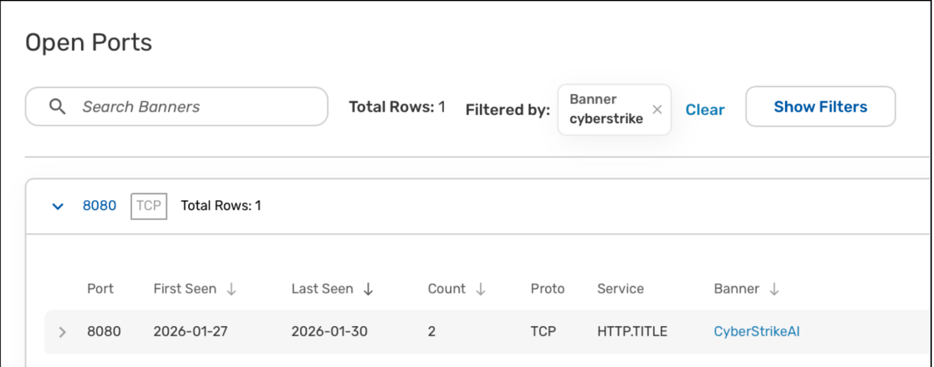

Section 5: Global Tracking and Infrastructure
CyberStrikeAI was first brought to our attention following the Amazon CTI team’s blog about AI-augmented threat actor infrastructure they had discovered. Amazon shared this related IP 212.11.64[.]250.
Analysis of that IP address in Team Cymru Scout’s open port scan data revealed that it had this “CyberStrikeAI” banner running on this service.
>

Slide 17
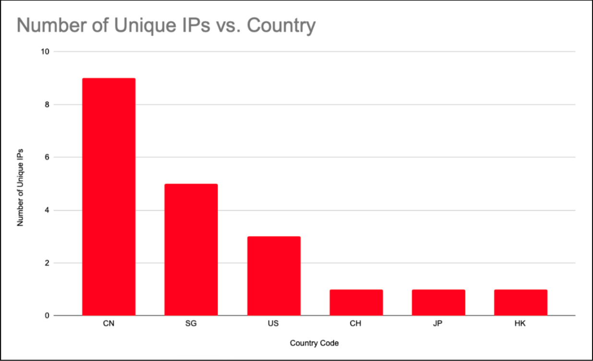
Section 5: Global Tracking and Infrastructure
Discovery: Tool first surfaced in late 2025; initial identification followed Amazon CTI team reports of AI-augmented infrastructure.
Deployment Trends:
Rapid growth: 21 unique IP addresses identified between Jan 20 and Feb 26, 2026.
Geographical Distribution:
Primary hosting locations: China, Singapore, and Hong Kong.
Hosting providers: Notable cloud usage of Tencent, Huawei, Alibaba, and others.
>

Slide 18
Section 6: CyberStrikeAI NetFlow Analysis

Slide 19
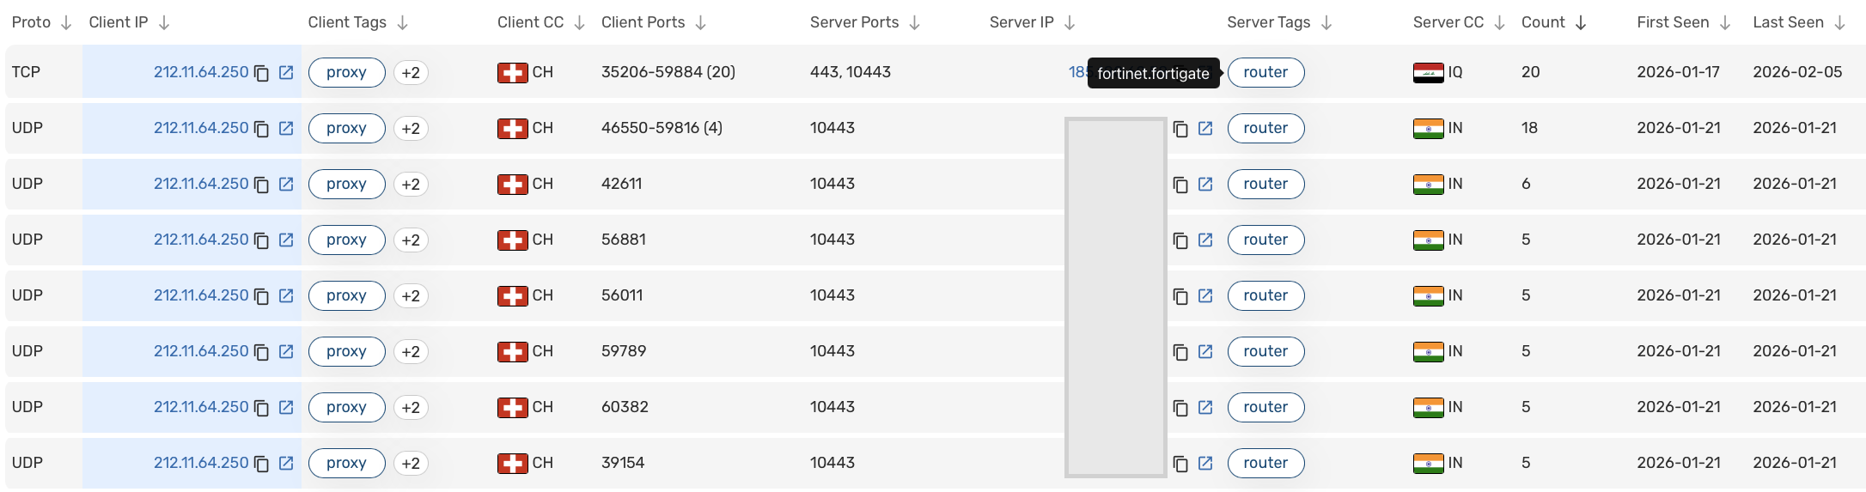
Section 6: CyberStrikeAI NetFlow Analysis
Using Team Cymru Scout, we can find NetFlow communications between the IP shared by Amazon and its targets, such as the Fortinet FortiGate devices it was observed targeting
>

Slide 20
Section 7: The Broader AI Toolset

Slide 21
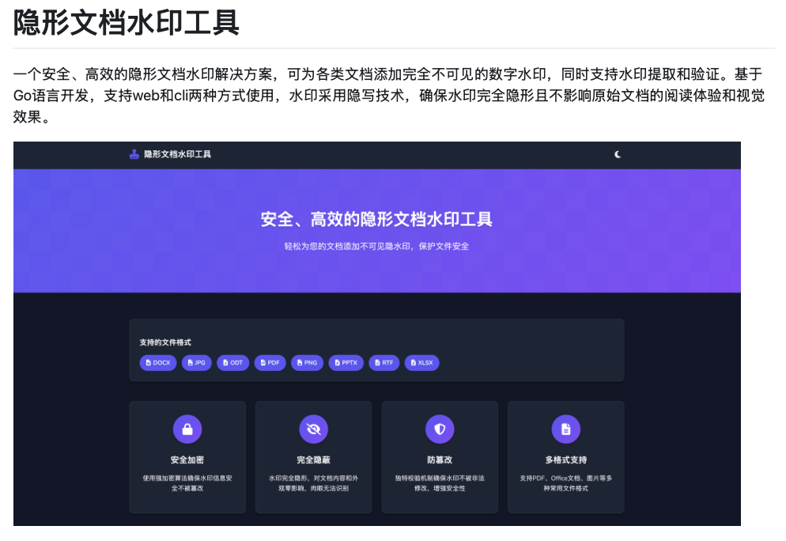
Section 7: The Broader AI Toolset
Ed1s0nZ’s watermark-tool:
A steganography solution for invisible document watermarking, potentially used for anti-data exfiltration security or tracking.
Developed in Go, it supports both web and CLI usage.
The watermark tool uses steganography technology to ensure that the watermark is completely invisible and does not affect the reading experience and visual effects of the original document.
>

Slide 22
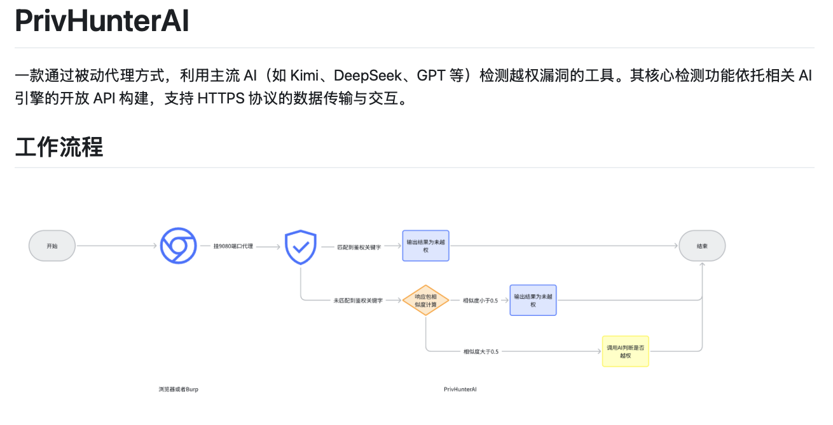
Section 7: The Broader AI Toolset
Ed1s0nZ’s PrivHunterAI:
This tool uses a passive proxy approach and mainstream AI (such as Kimi, DeepSeek, GPT, etc.) to detect leaked secrets and tokens in vulnerable applications and websites.
Its core detection function is built on the open APIs of the relevant AI engines and supports data transmission and interaction via HTTPS protocol.
>

Slide 23
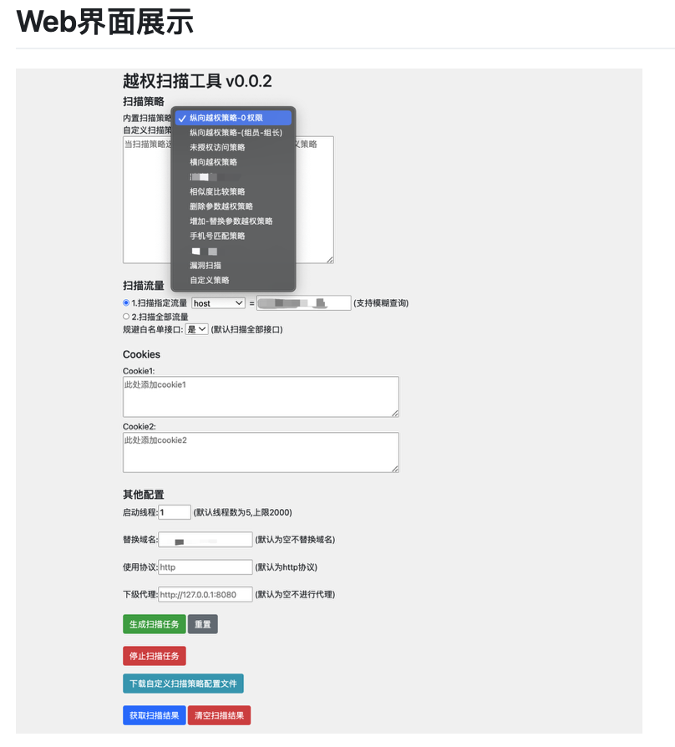
Section 7: The Broader AI Toolset
Ed1s0nZ’s InfiltrateX:
An automated privilege escalation scanning tool.
Could be used to gain admin access on target systems once initial access has been established.
Could be paired with CyberStrikeAI to escalate privileges and then move laterally inside the target environment.
Could be combined with newly released Proof-of-Concept Exploits that many orgs failed to patch in time.
>

Slide 24
Section 8: Outlook & Recommendations

Slide 25
Section 8: Outlook & Recommendations
Consider the AI Shadow Pipeline…
Chinese firms like DeepSeek use Distillation attacks to train their models.
They prompt US frontier models (like OpenAI’s GPT-4) millions of times and record the logic.
Unlike US models behind paywalls, these models are often released as Open-Weights.
Then, anyone can download the entire brain of a model and run it on their own servers, outside of any oversight or regulation.
Finally, this leads to high-intelligence models with zero guardrails that can be used for automated attacks, exploit or malware generation, and infrastructure creation.
>

Slide 26
Section 8: Outlook & Recommendations
Consider the ICS attack on Poland’s electrical grid…
Adversaries are using AI to scan and target internet-exposed ICS components (VPNs, routers, and industrial controllers) at an unprecedented scale.
Adversaries are aggressively targeting edge devices, such as Fortinet FortiGate firewalls, which serve as the primary gateway to critical infrastructure.
In December 2025, the Russian FSB-linked group Dragonfly breached Poland’s energy infrastructure by targeting exposed FortiGate VPNs that lacked MFA and rotated credentials.
As we saw in the NetFlow analysis, CyberStrikeAI was also observed automating the reconnaissance of those same type of FortiGate devices.
>

Slide 27
Section 8: Outlook & Recommendations
My Prediction: Anticipated acceleration in adoption of CyberStrikeAI and similar AI tools among Chinese-speaking threat actors and state-sponsored APTs.
Rapid and broad adoption in various areas
The Lowered Barrier to Entry: How AI-native engines automate exploitation, making sophisticated attacks more accessible to less-skilled actors.
What used to take a whole team, one operator can do alone
Defense Strategies:
Continuous monitoring of provided IP indicators (IOCs) shared in the blog.
Threat detection programs focused on finding offensive tooling, like CyberStrikeAI.
Preparation for automated, AI-driven targeting of vulnerable edge devices.
The importance of proactive threat hunting and NetFlow visibility.
>

Slide 28

Section 8: Outlook & Recommendations
>

Slide 29
Thank You

